Slide 1
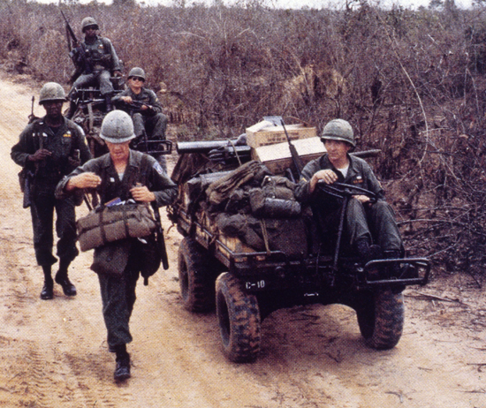
Escalation of the Vietnam War 22-2

Slide 2
Terms and People
William Westmoreland − the American military commander in South Vietnam
napalm − jellied gasoline that was dropped in canisters and exploded on impact, setting fire to large areas
hawk − a supporter of Johnson’s war policies
dove − an opponent of Johnson’s war policies

Slide 3
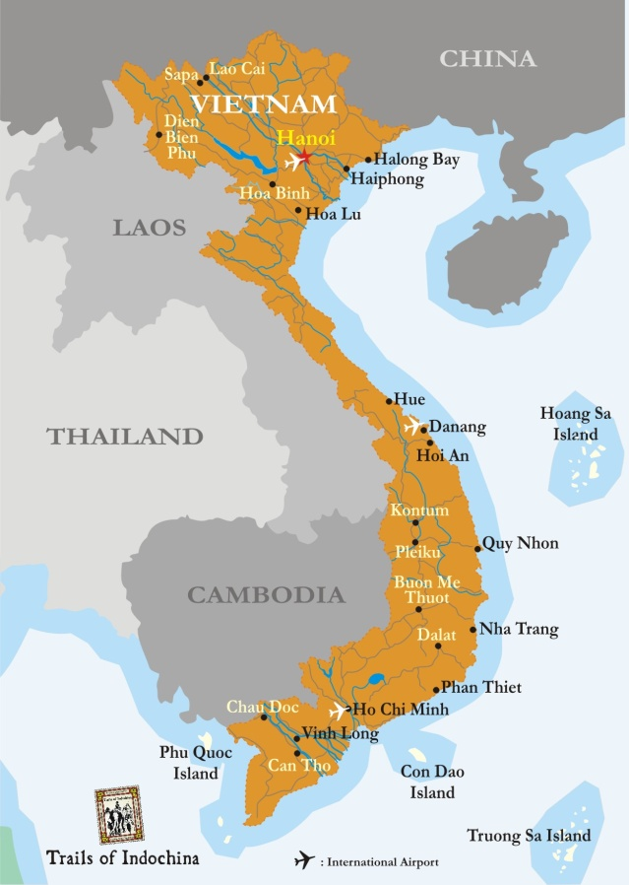
In 1965, the Vietcong attacked and killed American troops at Pleiku.
In response, Johnson escalated air strikes against North Vietnam and increased the number of ground troops.

Slide 4
This plan greatly increased American involvement in Vietnam.
The United States would use its superior war technology to win the conflict quickly.
Johnson’s advisers, including William Westmoreland, the American commander in Vietnam, supported the increased military presence.
125,000 troops

Slide 5
The North Vietnamese and Vietcong fighters proved a difficult enemy.
Ho Chi Minh’s military strategy was to fight only when victory was certain.
He pressed his troops to be like a tiger fighting an elephant—the tiger keeps moving and takes bites out of the elephant.

Slide 6
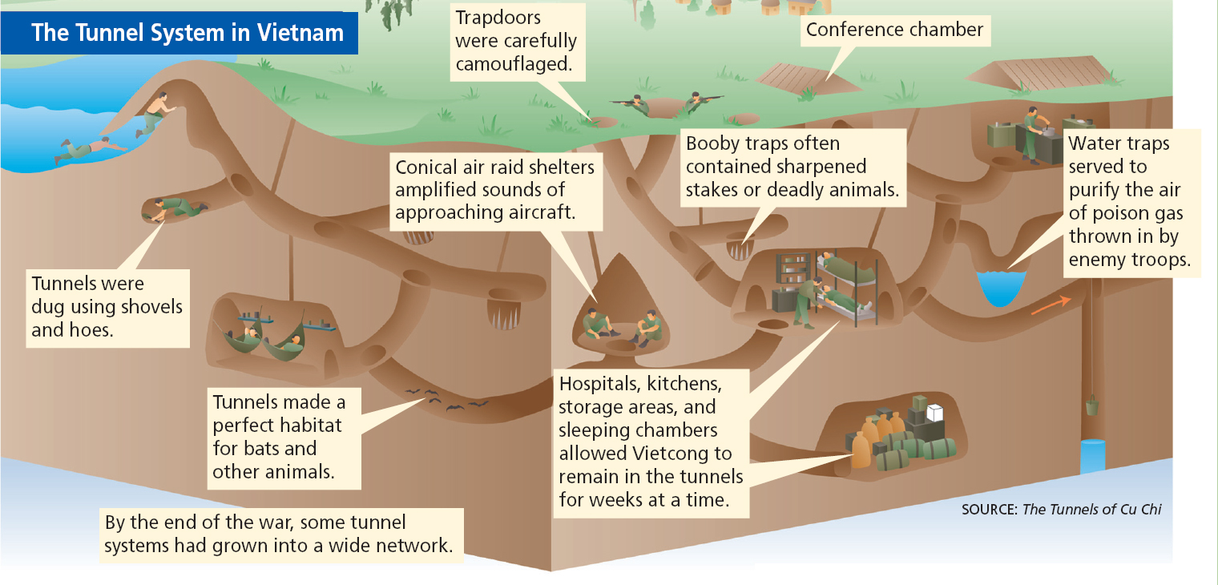
The Vietcong and North Vietnamese dug a complex series of tunnels, from which they mounted surprise attacks.

Slide 7
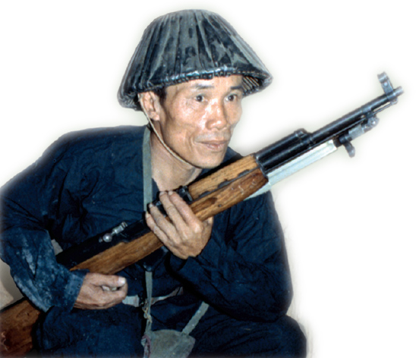
The Vietcong and North Vietnamese soldiers:
traveled quickly and quietly with little gear
attacked suddenly and then faded into the jungle
set booby traps around U.S. encampments
were difficult to tell apart from friendly Vietnamese

Slide 8
The United States used a variety of strategies against the Vietcong.
Six million tons of bombs were dropped on enemy positions.
The herbicide Agent Orange was sprayed to defoliate the countryside. Napalm covered large areas in flames.
http://en.wikipedia.org/wiki/Agent_Orange
Soldiers conducted search-and-destroy missions.
Helicopters were used to ferry commandoes to and from remote locations for quick strikes.
Although American troops won numerous battles, they could not win this unconventional war outright.

Slide 9
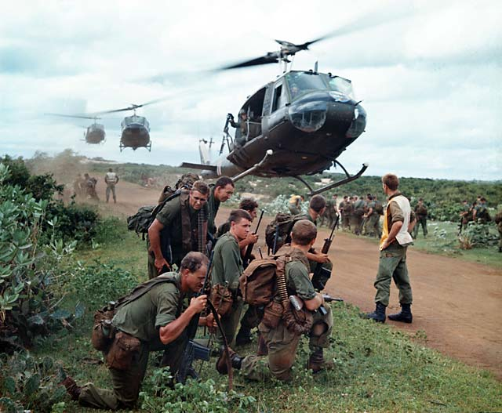
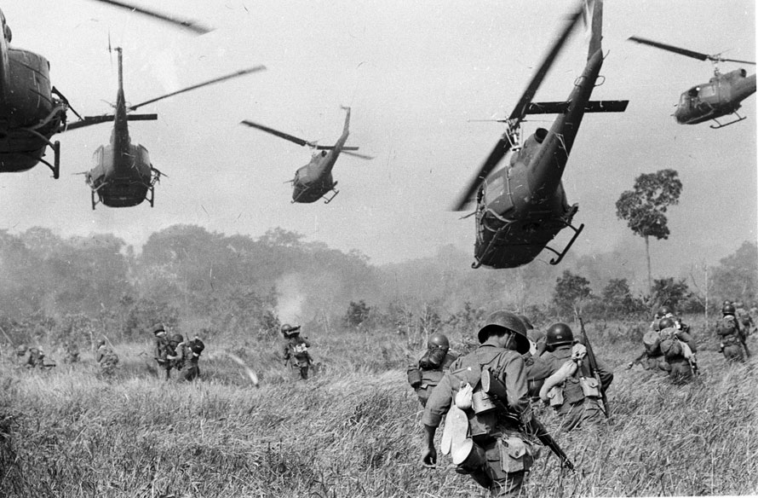

Slide 10
The war grew increasingly difficult and frustrating.
Many American soldiers had been drafted and did not see how the war helped U.S. interests. The lack of progress toward victory in Vietnam increased doubt about the war. The war strained America’s economy.

Slide 11
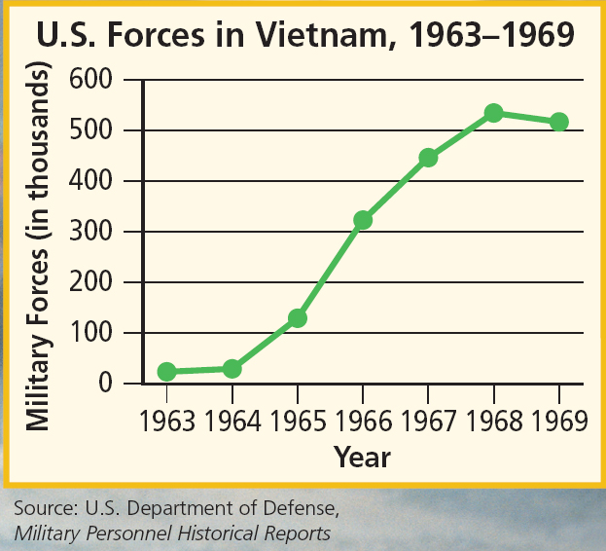
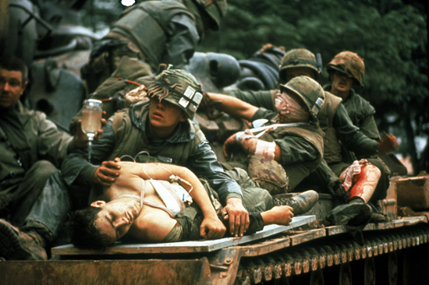
By 1968, there were more than half a million American troops in Vietnam, and over 30,000 had died.

Slide 12
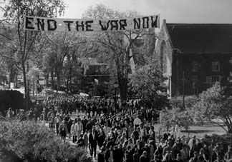
Doves questioned the war. They included liberal politicians and students who saw the conflict as a localized civil war.
Hawks supported Johnson’s war policies. They were mostly conservatives who believed the war was crucial to an American Cold War victory.

